Slide 1
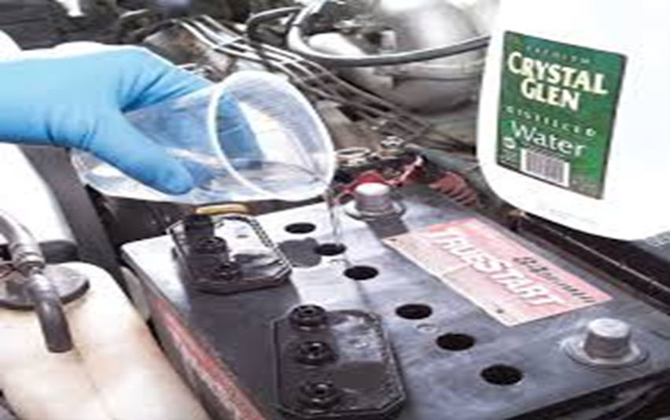
Mechanical Maintenance
Video : Introduction to Motor Mechanics
https://youtu.be/wL8DpEu_3es?si=Ko6OzfBU0VOQBwV9

Slide 2
Mechanical Maintenance
Safety rules
1.Work quietly and give full attention to the job you are doing.
2. Keep yours tools and equipment under control.
3. Keep jack handles out the way.
4. Never indulge in horseplay or other foolish action.
5. Never put screwdrivers or other sharp objects in your pockets.
6. Make sure your clothes are right for the job.
7. Do not wear rings, bracelet or watches when working around moving machinery or electrical equipments.
8. Wipe oil or greases off your hands and tools.
9. Clean spills of oil, grease or any liquid on the floor.
10. Watch out for sparks flying from grinding wheel or a welding job.
11. Never use compressed air to blow dirt from your clothes.
12.Always wear eye protection when liquid spray or particles are flying about.
13. When using a jack, position it properly.
14. Keep your hands away from the engine fan and accessory drive belts when the engine is running.
Video: https://youtu.be/Ux1wJusNUIY?si=lc4py7yJFe2qTtbt
Feedback : Activity

Slide 3
Kwa Thema Skills School
Subject : Maintenance Marks : 10
Grade : Year 1 Time : 30 mins
Date : / / 2024
Question:1
1. Fill in the following sentences.
1.1._______ quietly and give full attention to the job you are doing.
1.2. Keep yours tools and _________ under control.
1.3. Keep _______ handles out the way.
1.4. Never indulge in horseplay or other ________ action.
1.5. Never put _____________ or other sharp objects in your pockets.
1.6. Make sure your ________ are right for the job.
1.7. Do not wear rings, bracelet or _________ when working around moving machinery or electrical equipments.
1.8. Wipe oil or _________ off your hands and tools.
1.9. Clean spills of oil, grease or any _________ on the floor.
1.10. Watch out for __________ flying from grinding wheel or a welding job.

